Slide 1
William Stallings
Computer Organization and Architecture
8th Edition
Chapter 17
Parallel Processing

Slide 2
Multiprocessor Configurations
Flynn’s classification, Parallel processing concepts, Introduction to pipeline processing and pipeline hazards, design issues of pipeline architecture, Instruction pipelining

Slide 3
Parallel Processing Concepts
To fulfil increasing demands for higher performance
Need to process data concurrently to achieve better throughput
Parallelism
  Multiple functional units-several ALU’s
  Multiple processors-several processors operating concurrently

Slide 4
Flynn’s Classification
Based on
  Internal organization of processors
  Interconnection Structures
  Instruction Stream
  Instruction from main memory to processor
  Data Stream
  Operands flowing to and from the processor

Slide 5
FLYNN’s CLASSIFICATION
Multiple Processor Organization
Single instruction, single data stream - SISD
Single instruction, multiple data stream - SIMD
Multiple instruction, single data stream - MISD
Multiple instruction, multiple data stream- MIMD

Slide 6
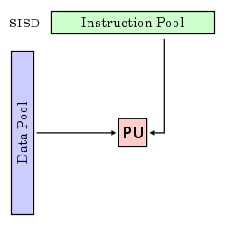

Slide 7
Single Instruction, Single Data Stream - SISD
Single processor
Single instruction stream
Data stored in single memory
Uni-processor

Slide 8
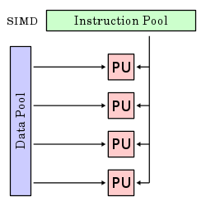

Slide 9
Single Instruction, Multiple Data Stream - SIMD
Single machine instruction
Controls simultaneous execution
Number of processing elements
Each processing element has associated data memory
Each instruction executed on different set of data by different processors
Vector and array processors

Slide 10
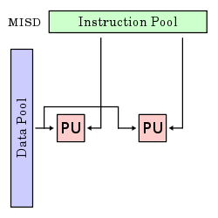

Slide 11
Multiple Instruction, Single Data Stream - MISD
Sequence of data
Transmitted to set of processors
Each processor executes different instruction sequence
Never been implemented

Slide 12
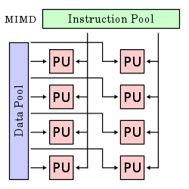

Slide 13
Multiple Instruction, Multiple Data Stream- MIMD
Set of processors
Simultaneously execute different instruction sequences
Different sets of data
SMPs, NUMA systems

Slide 14
Introduction to pipeline processing and pipeline hazards
Pipelining- Temporal overlapping of processing
Subdivide input task(process) into a sequence of subtasks
Each executed by specialized hardware that operates concurrently with other stages of pipeline

Slide 15
Pipelining allows the next instructions to be fetched while the processor is performing arithmetic operations
Holds them in a buffer close to the processor until each instruction operation can be performed.
The staging of instruction fetching is continuous.

Slide 16
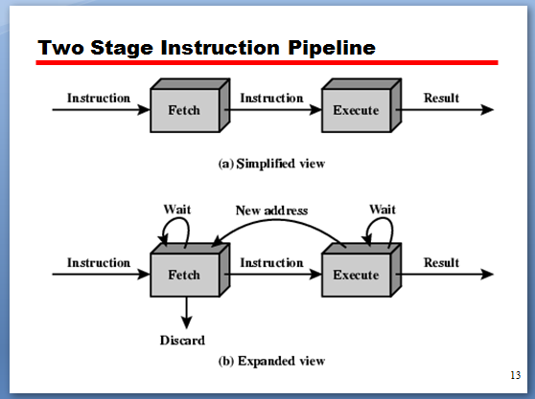

Slide 17
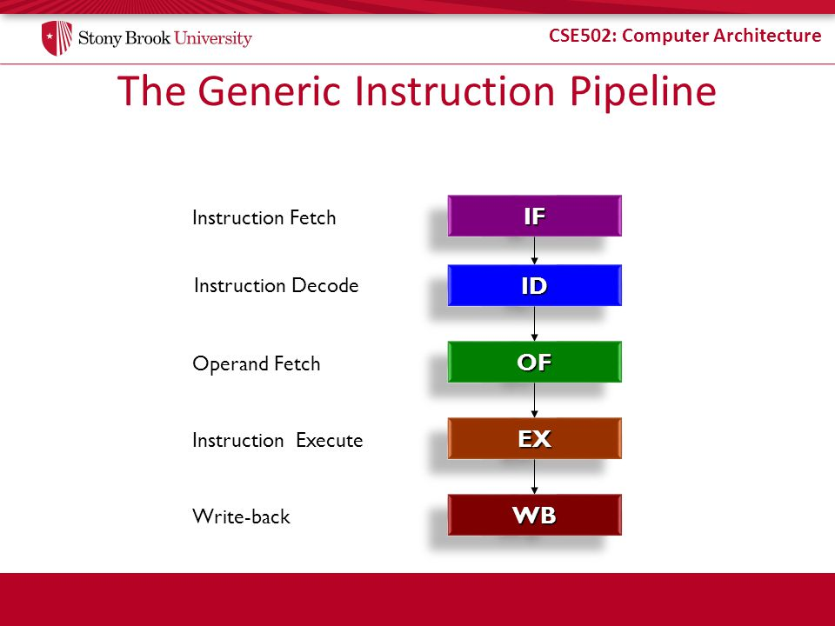

Slide 18
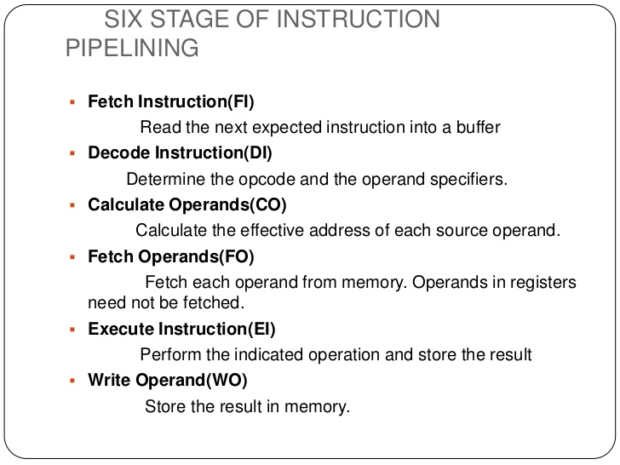

Slide 19
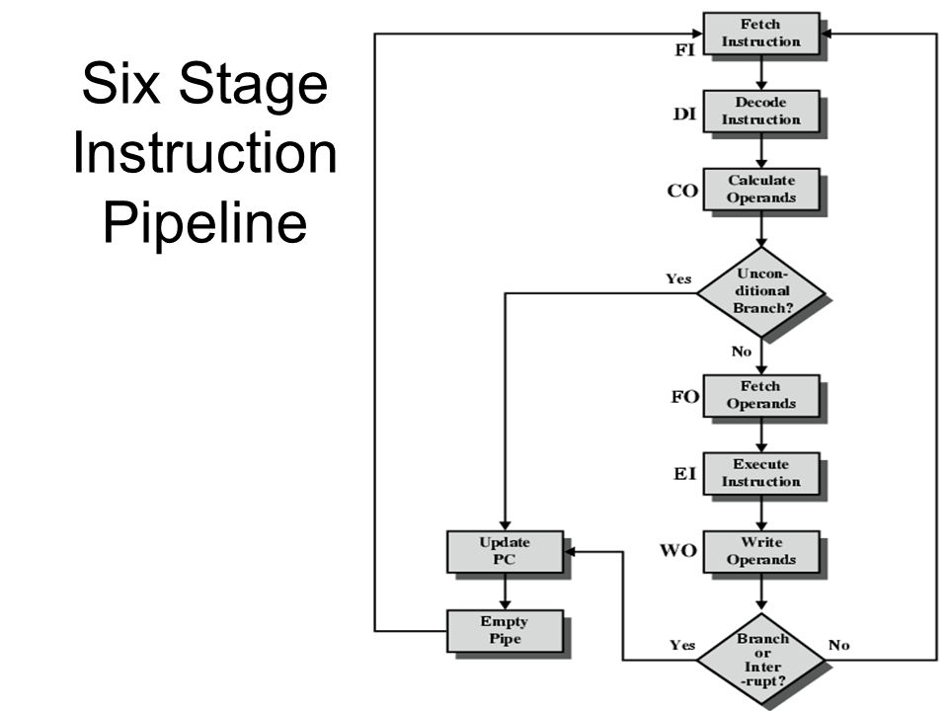

Slide 20
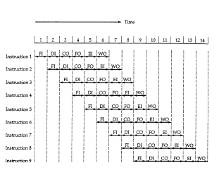
Timing diagram for 6 stage instruction pipeline

Slide 21
Pipeline hazards
Any reason that causes the pipeline to stall is called hazard or conflict
Resource usage ( inter instruction dependencies)
Job scheduling problems

Slide 22
3 types of Hazards
RESOURCE CONFLICTS
  insufficient resources
DATA or DATA DEPENDENCY CONFLICTS
  instruction in pipeline depend on result of previous instruction which still in pipeline yet to be completed
BRANCH DIFFICULTIES-Contents of PC get changed

Slide 23
RESOURCE HAZARD
Stalling pipeline causes Structural Hazard
Commonly need Memory Access
  Use separate cache for instruction and data

Slide 24
DATA HAZARD
  RAW
  WAW
  WAR
  RAR?
Rearrange the pipeline- pipeline scheduling

Slide 25
BRANCH HAZARDS
Flush Pipeline
Delayed branching
Conditional branching

Slide 26
Design issues of pipeline architecture
Instruction Pipeline design
  Instruction Issuing
    In order issuing, out of order issuing or re order issuing
Arithmetic Pipeline design
  Fixed point , floating point , integer arithmetic

Slide 27
Principles of designing pipelined processors
Proper data buffering to avoid congestion and smooth pipeline operations
Instruction dependence relationship
Logic hazards should be detected and resolved
Avoid Collisions and structural hazards by proper sequencing
Reconfiguration of the pipeline should be possible

